Slide 1
ITMD 421 – Data Modeling and Applications
Aastha Gupta
Lecture 6
October 2nd, 2017

Slide 2
Objectives
Midterm Review
Final Project
Data Definition Language
Data Types
Constraints

Slide 3
Midterm
Take-home exam
Posted on Blackboard – Oct 8th
Due Oct 16th (before class)
Zero after that
All work submitted should be original

Slide 4
Midterm
Some True/False questions
One or two short-answer questions
Normalization
E-R diagram
SQL queries

Slide 5
Final Project
Final Project will be posted this Friday.
October 6th
Due Dec 1st
Final Exam (In Class)
Dec 4th

Slide 6
SQL Statements - Categories
Data Manipulation Language (DML)
SELECT
Data Control Language
GRANT
INSERT
UPDATE
DELETE
MERGE
Data Definition Language (DDL)
CREATE
ALTER
DROP
RENAME
TRUNCATE
REVOKE

Slide 7
Data Definition Language
Object | Description
Table | Is the basic unit of storage. Composed of rows.
View | Represents subset of data from one or more than one table
Sequence | Generates numeric values
Index | Improves the performance of some queries
Synonym | Gives alternate name to an object

Slide 8
Table Structure
Tables can be created at any time, even when users are using the database.
Table structure can be modified online.
You do not need to specify the size of a table. The size is ultimately defined by the amount of space allocated to the database as a whole. It is important, however, to estimate how much space a table will use over time.

Slide 9
Naming Rules
Table names and column names must:
Begin with a letter
Can be 1–30 characters long
Contain only A–Z, a–z, 0–9, _, $, and #
Not be an server–reserved word
Names are not case-sensitive

Slide 10
CREATE TABLE STATEMENT
Syntax
CREATE TABLE table
(column1 datatype1 [DEFAULT expr]
column2 datatype2
…..
columnN datatypeN);
You specify:
The table name
The column name, column data type, and column size

Slide 11
DATA TYPES

Slide 12
CREATE TABLE -DEPT
CREATE TABLE DEPARTMENT
(
Dname VARCHAR(20),
DINT INT(1),
Mgr_ssn INT(9),
Mgr_start_date DATE,
PRIMARY KEY (DINT),
FOREIGN KEY (Mgr_ssn)
REFERENCES EMPLOYEE (Ssn)
);

Slide 13
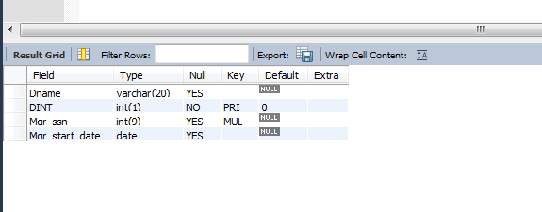
DISPLAY TABLE STRUCTURE
DESCRIBE department

Slide 14
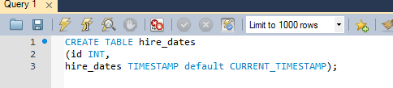
DEFAULT Option
Specify a default value for a column during the CREATE table.
Literal values, expressions, or SQL functions are legal values.
Another column’s name is illegal values.
The default data type must match the column data type

Slide 15

Constraints
Constraints enforce rules at the table level.
Constraints ensure the consistency and integrity of the database.
The following constraint types are valid:
NOT NULL
UNIQUE
PRIMARY KEY
FOREIGN KEY
CHECK

Slide 16
Constraint Guidelines
Create a constraint at either of the following times:
At the same time as the creation of the table
After the creation of the table
Define a constraint at the column or table level.

Slide 17
Define constraints
Syntax
CREATE TABLE [schema.]table
(column datatype [DEFAULT expr]
[column_constraint],
...
[table_constraint][,...]);

Slide 18
Define constraints
Example of a column-level constraint:
CREATE TABLE employees(
Customer_ID INT (6) NOT NULL ,
CONSTRAINT Cust_ID_PK PRIMARY KEY(Customer_ID),
first_name VARCHAR2(20),
...);
Example of a table-level constraint:
CREATE TABLE CUSTOMER
(
Customer_ID VARCHAR2 (6) NOT NULL ,
….. Phone_Number VARCHAR2 (15) ,
Credit_Card_Number VARCHAR2 (20) NOT NULL
ADD CONSTRAINT Cust_ID_PK PRIMARY KEY(Customer_ID)
);

Slide 19
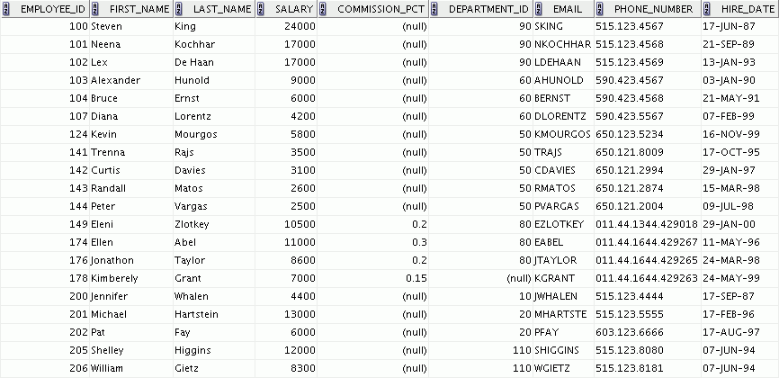
NOT NULL Constraint
Ensures that null values are not permitted for the column:
NOT NULL constraint
(Primary Key enforces NOT NULL constraint.)
Absence of NOT NULL constraint (Any row can contain a null value for this column.)
NOT NULL CONSTRAINT

Slide 20
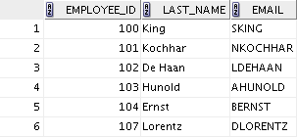
UNIQUE CONSTRAINT
UNIQUE constraint
INSERT INTO
Allowed
Not allowed: already exists

Slide 21
UNIQUE CONSTRAINT
Defined at either the table level
CREATE TABLE employees(
employee_id INT(6),
last_name VARCHAR2(25) NOT NULL,
email VARCHAR2(25),
salary INT(8),
commission_pct INT(2),
hire_date TIMESTAMP NOT NULL,
...
CONSTRAINT emp_email_uk UNIQUE(email));

Slide 22
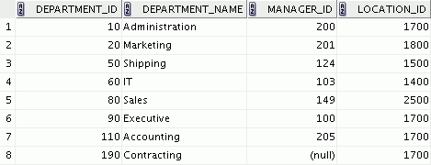
PRIMARY KEY CONSTRAINT
PRIMARY KEY
DEPARTMENTS
Not allowed
(null value)
INSERT INTO
Not allowed
(50 already exists)

Slide 23
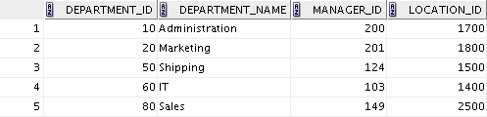
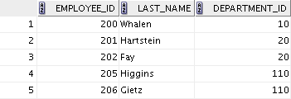
FOREIGN KEY CONSTRAINT
DEPARTMENTS
PRIMARY KEY
EMPLOYEES
FOREIGN KEY
Not allowed (9 does not exist)
Allowed

Slide 24
FOREIGN KEY CONSTRAINT
Defined at either the table level or the column level:
CREATE TABLE employees(
employee_id INT(6),
last_name VARCHAR2(25) NOT NULL,
email VARCHAR2(25),
salary INT(8),
commission_pct INT(2),
hire_date TIMESTAMP NOT NULL,
...
department_id INT(4),
CONSTRAINT emp_dept_fk FOREIGN KEY (department_id)
REFERENCES departments(department_id),
CONSTRAINT emp_email_uk UNIQUE(email));

Slide 25
FOREIGN KEY Constraint: Keywords
FOREIGN KEY: Defines the column in the child table at the table-constraint level
REFERENCES: Identifies the table and column in the parent table
ON DELETE CASCADE: Deletes the dependent rows in the child table when a row in the parent table is deleted
ON DELETE SET NULL: Converts dependent foreign key values to null

Slide 26
CHECK Constraint
It defines a condition that each row must satisfy.
It cannot reference columns from other tables
..., salary INT(2)
CONSTRAINT emp_salary_min
CHECK (salary > 0),...

Slide 27
Violating Constraints
Operations that violate domain constraints, entity integrity, or referential integrity are rejected by default
SQL can specify alternatives for foreign and primary keys ON UPDATE and ON DELETE
CASCADE, SET NULL, SET DEFAULT

Slide 28
ALTER TABLE Statement
Use the ALTER TABLE statement to:
Add a new column
Modify an existing column definition
Define a default value for the new column
Drop a column
Rename a column
Change table to read-only status

Slide 29
ALTER TABLE Statement
Use the ALTER TABLE statement to add, modify, or drop columns:
ALTER TABLE table
ADD (column datatype [DEFAULT expr]
[, column datatype]...);
ALTER TABLE table
MODIFY (column datatype [DEFAULT expr]
[, column datatype]...);
ALTER TABLE table
DROP (column [, column] …);

Slide 30
Adding a Column
You use the ADD clause to add columns:
ALTER TABLE department
ADD (job_id VARCHAR2(9));

Slide 31
Modifying a Column
You can change a column’s data type, size, and default value.
A change to the default value affects only subsequent insertions to the table.
ALTER TABLE department
MODIFY (dname VARCHAR2(25));

Slide 32
Dropping a Column
Use the DROP COLUMN clause to drop columns that you no longer need from the table:
ALTER TABLE department
DROP (job_id);

Slide 33
Quiz
To do which three of the following can you use constraints?
Enforce rules on the data in a table whenever a row is inserted, updated, or deleted.
Prevent the dropping of a table.
Prevent the creation of a table.
Prevent the creation of data in a table.

Slide 34
Example
(StudentID, Name, Age, Standing)
Create table – Student
Add constraint – Name is NOT NULL
Enforce an age range (between 10 and 70)
Enforce freshman age (less than 30)
Add column Address
Add column Income, Taxes – Number(5)

Slide 35
Example
(StudentID, Name, Age, Standing)
7. Drop column Address
8. Modify column Taxes - NUMBER(5, 2)
9. Rename Column Taxes to Tax

Slide 36
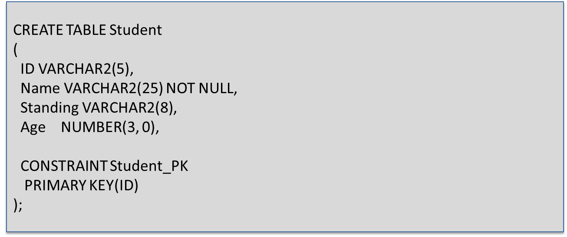
Example

Slide 37
Example
ALTER TABLE Student
ADD CONSTRAINT CheckName
CHECK (Name IS NOT NULL);

Slide 38
Example
ALTER TABLE Student
ADD CONSTRAINT AgeRange
CHECK (Age BETWEEN 10 and 70);
ALTER TABLE Student
ADD CONSTRAINT FreshmanAge
Check (Standing = 'Freshman' AND Age < 30);

Slide 39
Example
ALTER TABLE Student
ADD Address VARCHAR2(15);
ALTER TABLE Student
ADD (
Income NUMBER(5, 2),
Taxes NUMBER(5)
);

Slide 40
Example
ALTER TABLE Student
DROP COLUMN Address;
ALTER TABLE Student
MODIFY Taxes NUMBER(5, 2);
ALTER TABLE Student
RENAME Column Taxes TO Tax;

Slide 41
Thank You
No live Class – Next Week
Midterm week – October 9th
There are no assignments this week.
ALL THE BEST!!

